Slide 1
Loan Prediction Model Using Machine Learning
- Shubham sapkal

Slide 2
Motivation
Distribution of the loan is some how main business of almost every banks. Earning interest income is the most fundamental incentive for banks. Commercial banks lend money, charging different interest rates to different customers to balance the different risk profiles of each borrower. Asset in
The prime objective in banking environment is to invest their asset in safe hands.
Many banks approves loan after a regress process of verification and validation but still there is no surety whether the chosen applicant is deserving right applicant out of all applicants.
A bank's profit or a loss depends to a large extent on loans. By predicting the loan defaulters, the bank can reduce its Non- Performing Assets
Through this system we can predict whether that applicant is safe or not to give loan using machine learning

Slide 3
Background
The loan prediction is clear classification problem as we need to classify whether the loan status is Yes or No. So this can be solved using different classification algorithms like Logistic Regression, Decision Tree, Random Forest, KNN.
Sections
Data Collection
Comparison of Machine Learning Models
Training of system
Testing Data Set
Applying Model and Predicting Loan.
Every applicants details are filled during application for loan and this data can be used for prediction

Slide 4
Problem Statement
Loan Prediction can be very useful for bank’s Employee as well as the applicants. Aim of this prediction is to reduce time and make an easy way to choose the deserving applicant. The Loan Prediction system can calculate weight of each features taking part in loan processing and on new test data set same features are processed with respect to their associated weight.

Slide 5
Objectives :
The primary goal is to extract patterns from a common loan approved dataset and then buid a model based on these patterns. Some analysis will be done to find most important feature among all or the factors that affect the prediction result the most.
Some analysis will be done to find most important feature among all or the factors that affect the prediction result the most.

Slide 6
Dataset
Variables and Description | Data Type
Loan_ID | object
Sex (Male/Female) | object
Marital_Status(Married or not) | object
No_Dependents | object
Education_Status | object
Self_Employed(y/n) | object
Income | integer
Coapplicant_Income | float
Loan_Amount | integer
Tenure | float
Credit_History | float
Property_Area (Urban/Semisurban/Rural) | object
Loan_Status(Y/N) | object

Slide 7
WorkFlow
Exploratory Data Analysis (EDA): Data Summarization and Visualization for understanding the data distribution and features
Feature Selection: Selecting relevant features that contribute to the prediction of loan.
Preprocessing: Data cleaning, handling null values, missing value imputation, dummy variable creation, data transformation, dimensionality reduction through PCA, scaling and normalization.
Model Selection: Modeling and ensemble modeling
Evaluation: Accuracy score, Cross Validation, Confusion matrix, AUC/ROC

Slide 8
EDA
There are 614 Rows and 13 Columns.
Out of 13 columns 4 float, 1 integer, 8 object
Created some new columns Total Income, EMI, & Balance
Filled Out Missing NaN Values with Mean for float and integer and mode for categorical data
Considering Business Logic We did not remove any outliers from Income, Coapplicant_income Fields
We Have Converted Categorical Data into Binary Data 0 and 1
e.g. Marital_Status,Sex,Education Status,Credit_History,No_Dependents

Slide 9
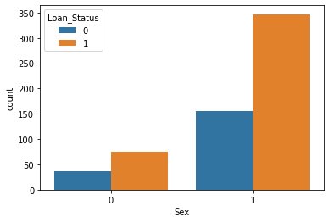
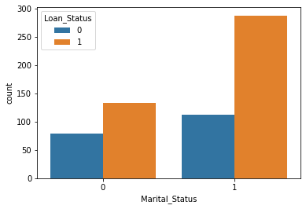
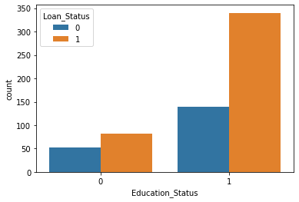
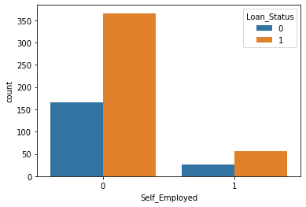
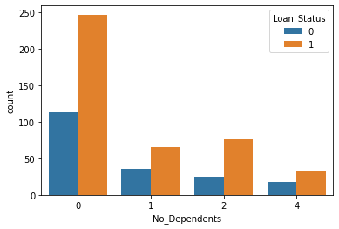
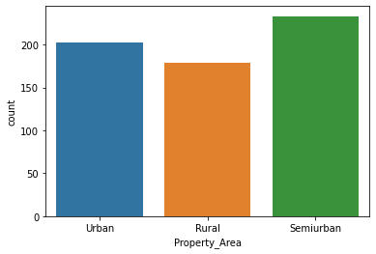
Univariant Analysis and visualization

Slide 10
Summary of EDA :
Out of 614 Applicants 422Applicants Loan is Approved i.e.68.72%
Out of 422 Loan approved Candidates:
82.22% are Male
68.24% are Married
80.56% Are Graduate
86.72% Are Not Self Employed
58.53 % Applicants are with 0 no of dependents
42% applicants are from Semi-urban Area
89.57% Applicants Loan is Approved when their Credit History is 1
If Credit History is 1 then 90% Chances of getting Loan Approved. And Also Male and Not Self Employed candidates also have higher chances of Loan Approval

Slide 11
Types Of Classification Algorithm We Used
Logistic Regression : It is a classification algorithm used to estimate discrete values(0/1,y/n) based on given set of independent variables. It uses Sigmoid Function.
Decision Tree Classifier : It is a graphical representation for getting all the possible solutions to a problem/decision based on given conditions.
Random Forest :Random Forest is a classifier that contains a number of decision trees on various subsets of the given dataset and takes the average to improve the predictive accuracy of that dataset.
K-Nearest Neighbor: KNN algorithm at the training phase just stores the dataset and when it gets new data, then it classifies that data into a category that is much similar to the new data

Slide 12
Comparison And Final Model
Algorithms | Accuracy on Training | Accuracy on Testing | ROC-AUC SCORE
Logistic Regression | 0.804473 | 0.821138 | 0.811146
Decision Tree Classifier | 0.806514 | 0.821138 | 0.725077
Random Forest Classifier | 0.796289 | 0.804878 | 0.745046
K-Nearest Neighbor | 0.806514 | 0.821138 | 0.732198

Slide 13
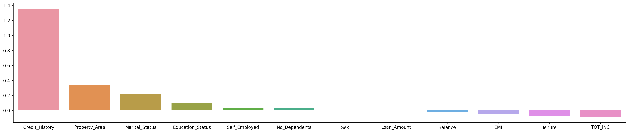
Feature Importance

Slide 14
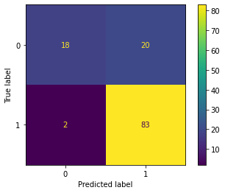
Final Model : logistic regression
Model Predicted out of 123 Applicants 103
Applicants Loan will be approved
But Actually 85 applicants Loan is Approved.
So When Threshold is 0.5 Model Predicted 20 Applicants Loan
is Approved For Actually Rejected Applicants .
This is Type 1 Error And will be lose of Bank.
Found Best threshold as 0.69 so that model will predict loan
rejected for some of them and type 1 error will reduced .

Slide 15
Loan approval prediction on given data
Applied Final Model Of Logistic Regression with Hyper-parameters as C=1, penalty=l1, solver=saga On Given Data of 367 Applicants.
By Default Threshold 0.5
59 Applicants Loan will be Rejected and 308 Applicants Loan Will Be Approved
But If we apply threshold as 0.69
93 Applicants Loan will be Rejected and 274 Applicants Loan Will Be Approved (53 applicants Loan is
rejected )

Slide 16
Conclusion And Future Scope
Overall, it depends on the business purpose or requirement to set the threshold for customer who are more likely to get loan approved. In general, 0.5 might be default threshold.
Threshold will depend on the error we want to remove either Type 1(<0.5) or Type 2(>0.5).
In Future, this model can be used to compare various machine learning algorithms generated prediction models and model which will give higher accuracy will be Prediction Model

